Slide 1
Computer Modeling and Simulation
By
Sara Rehmat
MS(CS)

Slide 2
Attributes of Queuing Model
A queuing model is described by its attributes: customer population, arrival and service pattern, queue discipline, queue capacity, and the number of servers.

Slide 3
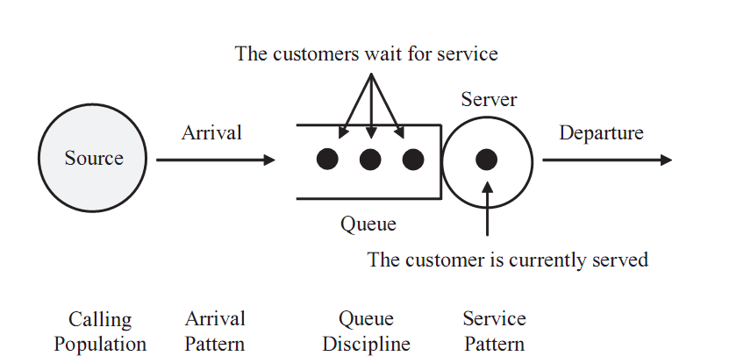
Components of a single-server Queuing Model

Slide 4
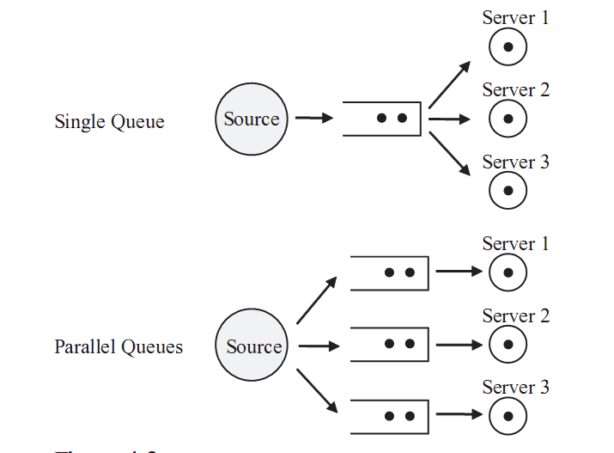
Single and Parallel Queues

Slide 5
Attributes of Queuing Model 1. Calling Population
The calling population , which can be either finite or infinite, is defined as “the pool of customers who possibly can request the service in the near future”.
If the size of the calling population is infinite, the arrival rate is not affected by others.

Slide 6
Attributes of Queuing Model 2. Queue Pattern
When a server becomes idle, the next customer is selected among candidates from the queue. The selection of strategy from the queue is called queue discipline.
The common algorithms of queue discipline are first - in first - out (FIFO), last - in first - out (LIFO), service in random order (SIRO), and priority queue.
The most common queue discipline is FIFO.
In a priority queue discipline, each arrival has its priority.
The priority scheme may be either preemptive or non-preemptive .
In a preemptive scheme, the customer currently being served is placed back at the front of the queue if the incoming customer has the higher priority than the customer has who is currently being served.
The displaced customer ’ s service may be either restarted or resumed.
In a non-preemptive scheme, the continuous service is provided for the
customer currently being served until it ends.

Slide 7
Attributes of Queuing Model 3. Arrival and Service Pattern
Arrival and service patterns are the two most important factors determining behaviors of queuing models.
A queuing model may be deterministic or stochastic .
For the stochastic case, new arrivals occur in a random pattern and their service time is obtained by probability distribution.
The arrival and service rates, based on observation, are provided as the values of parameters for stochastic queuing models.

Slide 8
Attributes of Queuing Model 4. Arrival Rate and Service Rate
The arrival rate is defined as the mean number of customers per unit time, and the service rate is defined by the capacity of the server in the queuing model.
If the service rate is less than the arrival rate, the size of the queue will grow infinitely.
The arrival rate must be less than the service rate in order to maintain a stable queuing system.
The randomness of arrival and service patterns cause the length of waiting lines in the queue to vary.

Slide 9

Probabiltiy Distribution of Processes in Queing Model
Note that there are three main processes in the system, the arrival process , the service process , and the departure process .
Arrival Process:
Suppose λ is the average arrival rate (e.g., customers arrive at a rate of λ per hour) and x is the number of customers.
The probability that x customers arrive in one hour is given by a Poisson statistical distribution.

Slide 10
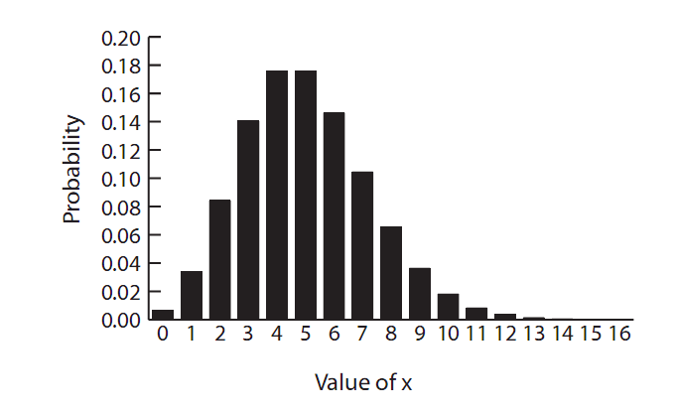
Arrival Process Probability Distribution

Slide 11

Inter-arrival Time Probability Distribution
Interarrival Time is the time between customer arrivals. This time is important because it will indicate the random time at which the next customer will arrive at the queue. This number will need to be computed for the simulation to account for the arrival of each customer.
The Interarrival Time is exponentially distributed and follows the probability function of equation

Slide 12

Service Time Probability Distribution
The service process is described by a different probability distribution which gives the service time interval probability or what is the probability that a customer ’ s service time will be between t₁ and t₂ .

Slide 13
Service Time Probability Distribution
The probability of a speciﬁc service time is computed in a similar manner to the inter-arrival time and follows the same function as that for inter-arrival time.
P(t) = e^{-μt}
Where μ is the average service time.

Slide 14
Attributes of Queuing Model 5. Balking, Reneging, Jockeying
If the length of waiting line is too long or the customers find a shorter line, they may leave the queue. Balking, reneging, and jockeying are such examples of impatient customers.
Balking occurs when an arriving customer does not enter the queue due to the limited queue capacity.
Reneging occurs when a customer in order to maintain a stable queuing system leaves the queue after waiting in a queue upon arrival.
Jockeying occurs when a customer decides to switch the queue for earlier service.
The decision of balking is deterministic, whereas those of reneging and jockeying are considered as probabilistic.

Slide 15
Attributes of Queuing Model 5. Notation
Kendall ’ s notation , A/B/c/N/K, is used to concisely define a queue and its parameters.
“ A ” and “ B ” represent the inter - arrival and service distribution, respectively; “ D ” (deterministic), “ M ” (Poisson), “ G ” (general), and
“ E_{k} “(Erlang) are used to represent “ A ” and “ B ” .
“ c ” represents the number of servers.
“ N ” represents the queue capacity;
“ K ” represents the size of the calling population.
Usually the A/B/c notation is used when “ N ” and “ K ” are infinite.
For example, M/M/1 represents a single server queuing model, and the inter - arrival and service time are exponentially distributed.
The queue discipline is often added to describe the system.
Here we will address only the M/M/1 type of queue.

Slide 16
Statistics Related to Queuing Model
The purpose of building a queuing model and running a simulation is to obtain meaningful statistics such as the server performance. The notations used for statistics

Slide 17
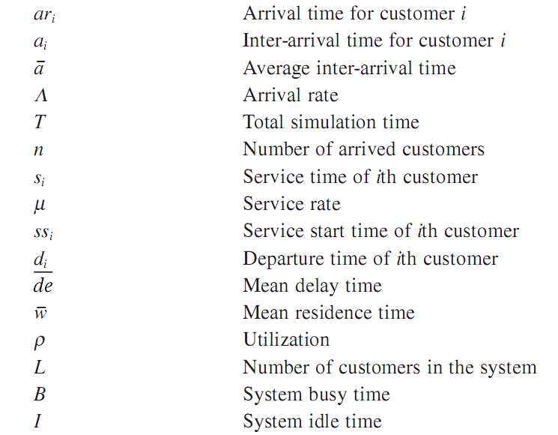
Statistics Related to Queuing Model

Slide 18
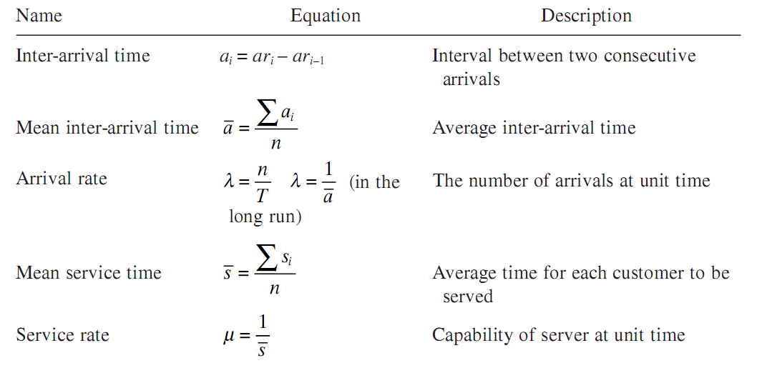
Equations for key Queue Modeling Statistics

Slide 19
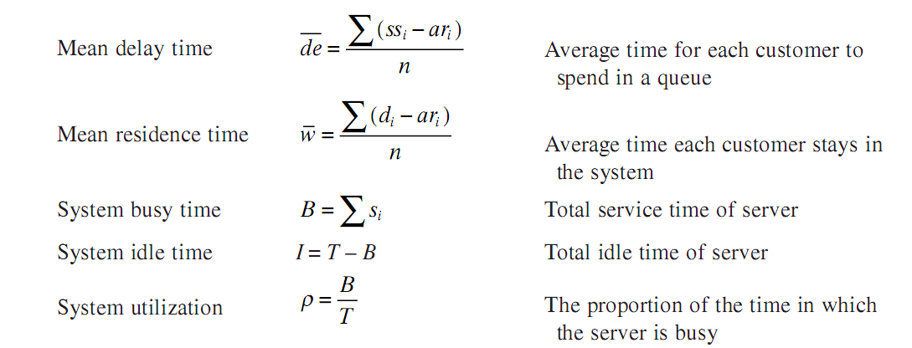
Equations for key Queue Modeling Statistics

Slide 20
Little’s Law
The average number of customers ( L ) is equal to the arrival rate ( λ ) multiplied by the average time ( w ) the customer spends in the system: L = λ w .
Little ’ s law is meaningful in that the law holds regardless of any kind of the arrival and service distribution.
Thus, Little ’ s law does not require restricted assumptions for the types of arrival and service patterns.

Slide 21
Example Simulation
Consider the following example of a grocery store with only one checkout counter.
The customer waits for the cashier in a line.
The arrival and service time for each customer are given in the following Table . Inter - arrival time and departure times can be calculated from the arrival and service time.

Slide 22
In a single - server queuing model, the customer waiting in the queue is not scheduled for service if another customer occupies the server.
The start of service time is affected by the departure of the previous customer.
Thus, the departure time is defined as d_{i} = max (d_{i-1}, ar_{i}) + s_{i}.

Slide 23
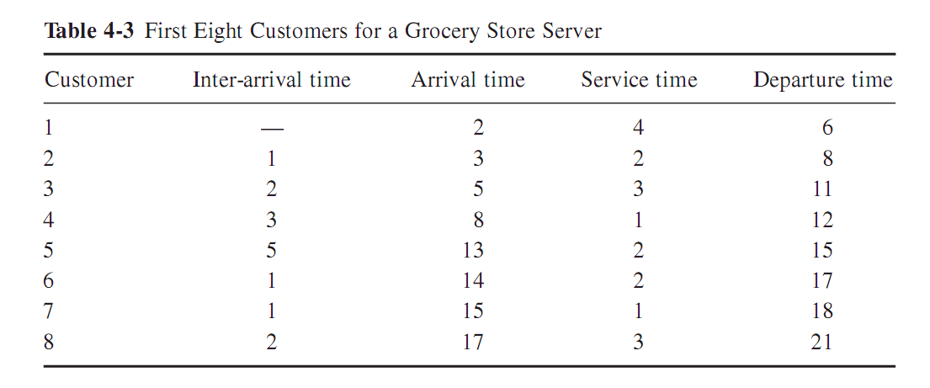

Slide 24
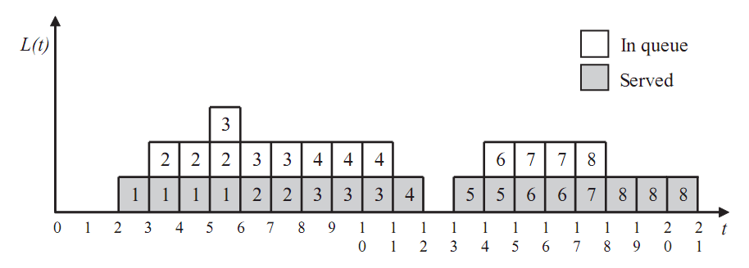
Example Simulation
Following figure graphically illustrates the simulation results over time,
showing the number of customers in the grocery store as time progresses.
L ( t ) denotes the number of customers in the system at time t.

Slide 25
Example Simulation
The average customer ( L ¯ ) at time t can be calculated from the figure as follows.
L ¯ = (1 + 2 + 2 + 3 + 2 + 2 + 2 + 2 + 2 + 1 + 1 + 2 + 2 + 2 + 2 + 1 + 1 + 1)/21 = 1.48.
The arrival rate ( λ ) is 8/21 = 0.38.
The mean residence time ( w ) is (4 + 5 + 6 + 4 + 2 + 3 + 3 + 4)/8 = 3.88.
The average number of customers in the system can be calculated from Little ’ s law: L = λ w = 0.38 × 3.88 = 1.48. The result of Little ’ s law is the same as that of simulation as shown in Figure .

